Slide 1
FortiGate Ansible Zero Touch Provisioning (FA-ZTP)
Luke Weighall
CSE DevOps

Slide 2
Introduction
Zero-Touch Provisioning is a data problem.
Ansible provides an abstraction layer for normalizing Organizational workflow data.
We are going to explore these layers to better understand the problem at hand.
Organizational Workflow Data
Ansible ZTP Role
Fortinet.FortiManager Ansible Galaxy Collection
Ansible Core
FortiManager API
FortiManager Objects
FortiGate Configs

Slide 3
Introduction
First we must understand what it takes to deploy a branch FortiGate.
Let’s explore the FortiManager Objects layer.
Organizational Workflow Data
Ansible ZTP Role
Fortinet.FortiManager Ansible Galaxy Collection
Ansible Core
FortiManager API
FortiManager Objects
FortiGate Configs

Slide 4
FortiManager Branch ZTP Object Layers
FortiManager API
ADOM
FortiGates
Routing
Normalized Interfaces
SSIDs
FortiAP Profiles
FortiAPs
Static Routes
WAN1
WAN2
FortiLink Ports
SD-WAN Underlay Zone
FortiSwitch VLANs
BGP
VPN1
VPN2
FortiSwitches
SD-WAN Overlay Zone
FSW Ports
FSW Ports
FSW Ports
FSW Ports
FSW Ports
WAN
LAN
Policy Packages

Slide 5
Routing Layer
FortiManager API
ADOM
FortiGates
Routing
Normalized Interfaces
FortiAPs
Static Routes
SD-WAN Underlay Zone
WAN1
FortiLink Ports
WAN2
FortiSwitch VLANs
BGP
FortiSwitches
SD-WAN Overlay Zone
VPN1
Route-Map In
Route-Map Out
Neighbor 65000:1
FSW Ports
FSW Ports
FSW Ports
FSW Ports
FSW Ports
VPN2
Route-Map In
Route-Map Out
Neighbor 65000:2
WAN
LAN
BGP Advertised Networks

Slide 6
SDWAN Layer
FortiManager API
ADOM
FortiGates
Normalized Interfaces
WAN1
WAN2
Remote Hub VPN 1
SDWAN Member
SDWAN Member
Remote Hub VPN 2
SDWAN Branch Underlay Zone
Internet
SDWAN Member
SDWAN Member
SDWAN Branch Hub Overlay Zone
VPN 1 Peer Interface IP
*:1 ← BGP Neighbors -> *:2
VPN 2 Peer Interface IP
Remote SDWAN Hub

Slide 7
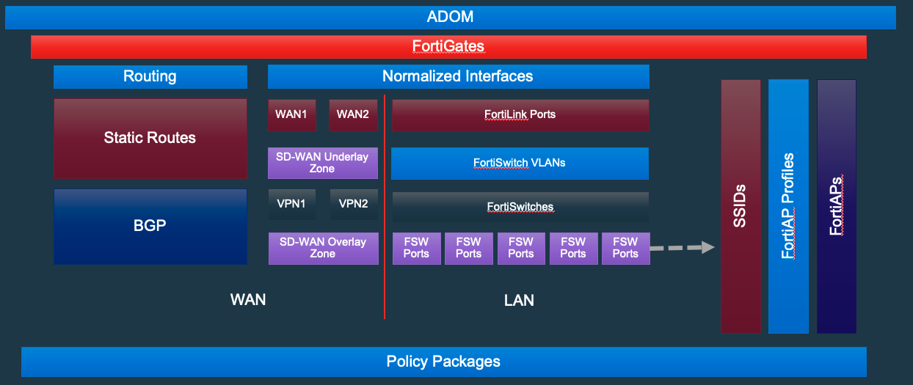
So how do we get here?
From Here?
Organizational Workflow Data
Ansible ZTP Role
Fortinet.FortiManager Ansible Galaxy Collection
Ansible Core
FortiManager API
FortiManager Objects
FortiGate Configs

Slide 8
Inter-Layer Connections
Organizational Workflow Data
Data Import & Validation
Ansible ZTP Role
Local Workstation Data Processing
Galaxy Collection Dedicated Modules
Galaxy Collection “Generic” Module
Fortinet.FortiManager Ansible Galaxy Collection
Ansible Core
HTTPAPI Ansible Connection
FortiManager API
Direct Object Creation
Config Scripts Object Creation
FortiManager Objects
FortiGate Configs

Slide 9
Inter-Layer Connections
Organizational Workflow Data
Let’s take a closer look at the Data Import & Validation Process
Data Import & Validation
Ansible ZTP Role
Local Workstation Data Processing
Galaxy Collection Dedicated Modules
Galaxy Collection “Generic” Module
Fortinet.FortiManager Ansible Galaxy Collection
Ansible Core
HTTPAPI Ansible Connection
FortiManager API
Direct Object Creation
Config Scripts Object Creation
FortiManager Objects
FortiGate Configs

Slide 10
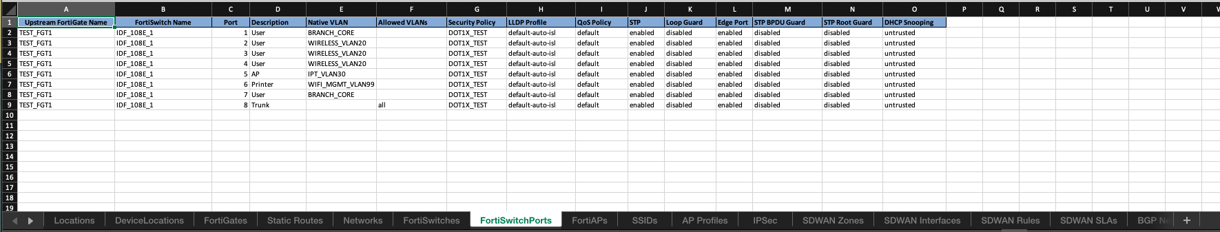
Included Example Spreadsheet
FortiGates
Routing
Normalized Interfaces
FortiAPs
SSIDs
FortiAP Profiles
Static Routes
WAN1
WAN2
FortiLink Ports
SD-WAN Underlay Zone
FortiSwitch VLANs
BGP
VPN1
VPN2
FortiSwitches
SD-WAN Overlay Zone
FSW Ports
FSW Ports
FSW Ports
FSW Ports
FSW Ports
WAN
LAN
Policy Packages

Slide 11
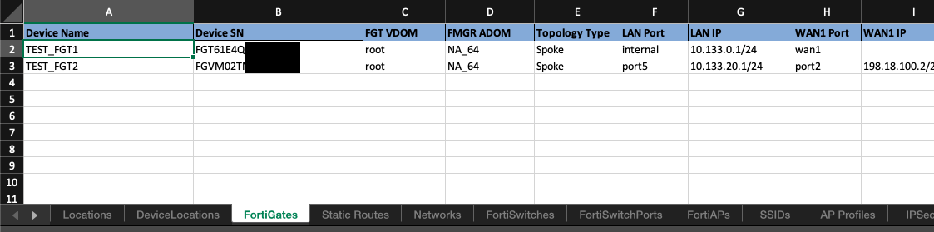

Included Spreadsheet Import
Organizational Workflow Data
Python Spreadsheet Conversion Script
Fail
Ansible ZTP Role
VALIDATE Input FortiGate Data
{{role_path}}/files/tmp/fortigates/*.yml
{{role_path}}/vars/fortigates/*.yml
Render to tmp folder
Manual Exceptions
TEST_FGT1.yml
TEST_FGT2.yml
TEST_FGT1.yml
TEST_FGT2.yml
PASS
Fortinet.FortiManager Ansible Galaxy Collection
Ansible Core
FortiManager API
FortiManager Objects
FortiGate Configs

Slide 12


Custom Database Import
Organizational Workflow Data
Custom Data Grouping/Flattening Script or Query
Custom Database
Custom Web Application
Included SQLAlchemy Data Model
Fail
Ansible ZTP Role
VALIDATE Input FortiGate Data
{{role_path}}/files/tmp/fortigates/*.yml
{{role_path}}/vars/fortigates/*.yml
Render to Role tmp folder
Manual Exceptions
TEST_FGT1.yml
TEST_FGT2.yml
TEST_FGT1.yml
TEST_FGT2.yml
PASS
Fortinet.FortiManager Ansible Galaxy Collection
Ansible Core
FortiManager API
FortiManager Objects
FortiGate Configs

Slide 13
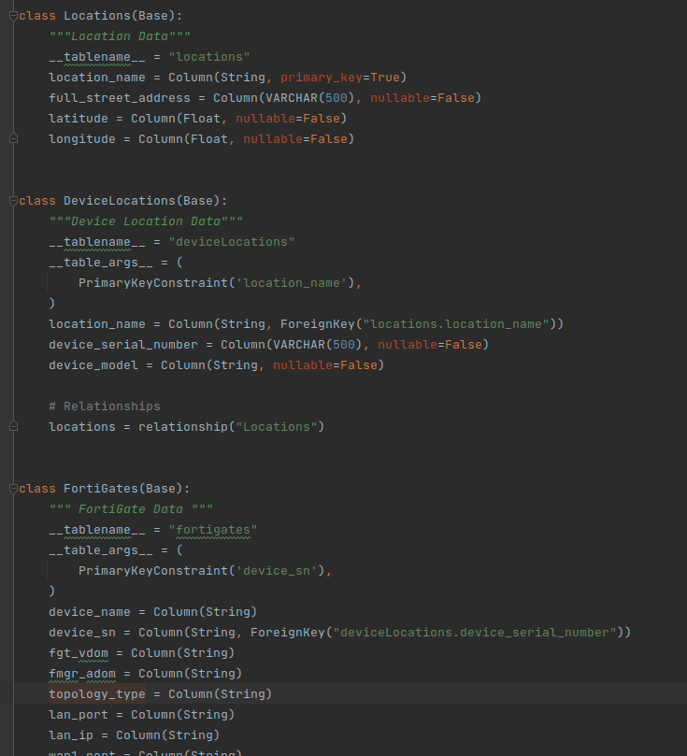
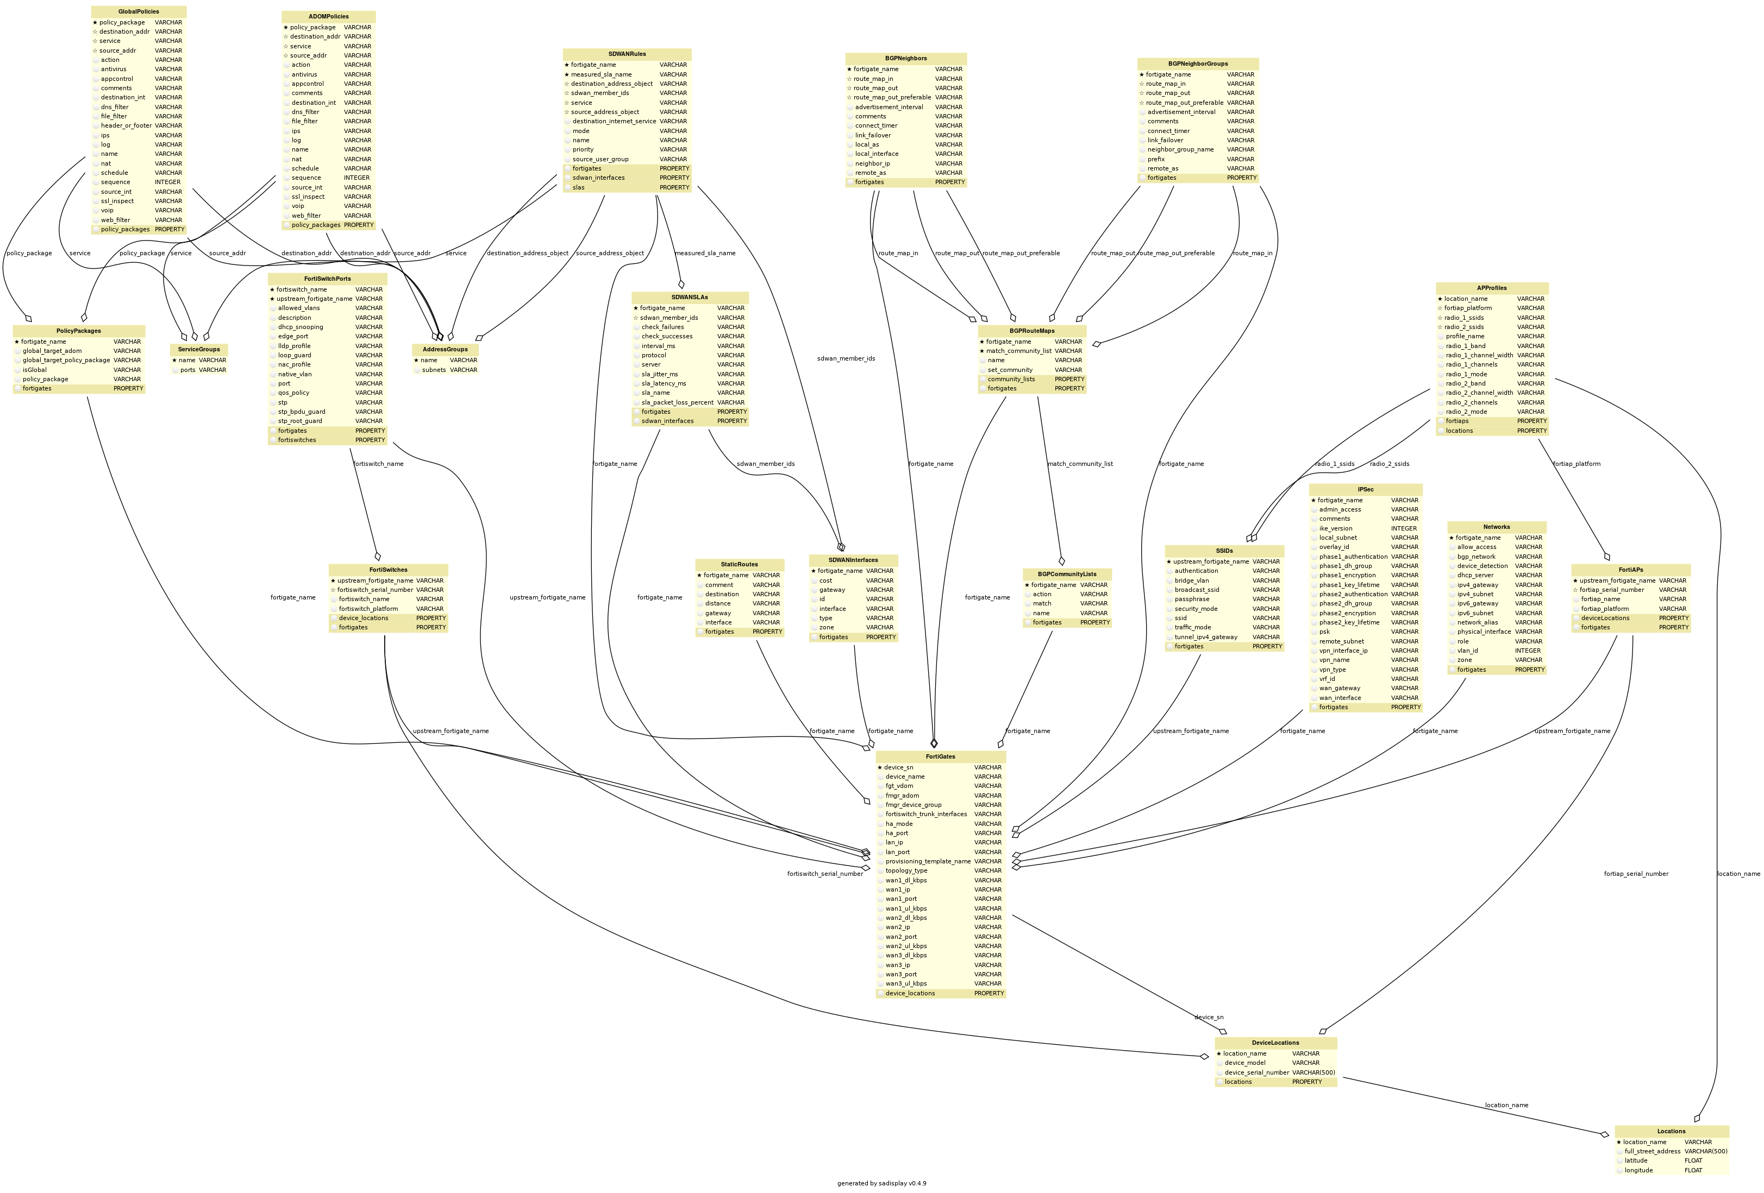
Organizational Workflow Data Model
We are using a spreadsheet as an included data source for importing FortiGate ZTP Data.
However, spreadsheets are not for everyone.
To aid in the design of an alternative input method, all spreadsheet tables (sheets), and attributes (columns) are modeled in Python SQLAchemy classes.
This allows for the quick generation of a UML Diagram and custom applications.
This is the real value of this Ansible Role – we’ve done the data modeling that organizations can use to accelerate their understanding of FortiGate ZTP.

Slide 14
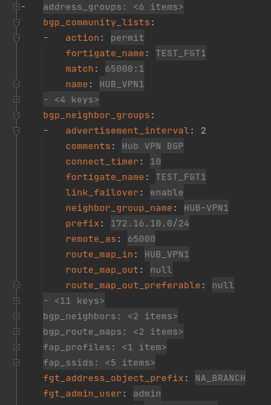
FortiGate YAML File Schema
The FortiGate YAML files must adhere to the “Ansible ZTP Role Data Model”.
We have defined this data model via Python Schema and implemented an automatic check for all imported data.
This schema can be extended by adding columns or sheets to the input spreadsheet (or custom database query).
This is the data schema that the included Jinja2 templates have all been coded to use.
If this schema changes, so must the Jinja2 templates.
Ansible Tasks in the ZTP Role also depend on this data model.
When Ansible ZTP Role runs, it reads every file as its own “dictionary” and merges all the files into a “list”.
That “list of dictionaries” is then looped to run ZTP tasks, within the role.
VALIDATE Input FortiGate Data

Slide 15
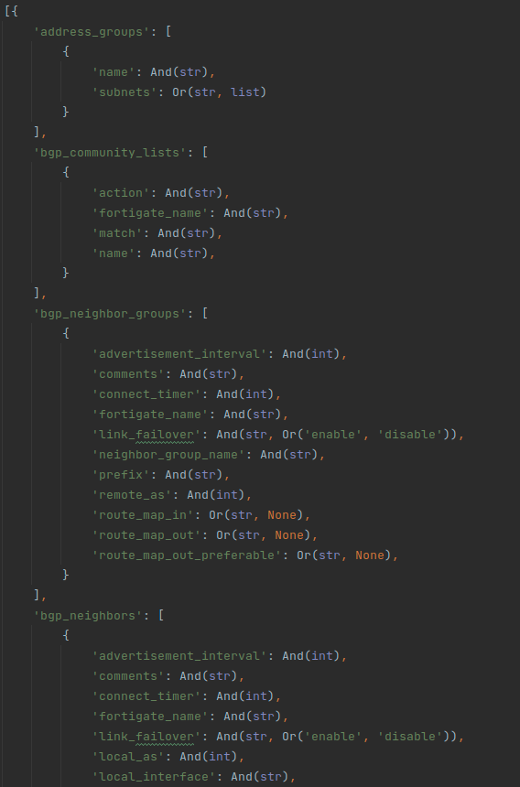
Validating Input Data
We can validate all rendered FortiGate data to the “Ansible ZTP Role Data Model”.
We’re using the Python “schema” package to accomplish this: https://pypi.org/project/schema/
We have included Ansible playbooks to do the validation immediately after rendering the tmp FortiGate files.
The role task can be found at: tasks/templates/validate_rendered_fortigates.yml
The Python script this task calls can be found at: files/python/ansible_ztp_role_data_model/validate_rendered_fortigates.py
The actual schema definition is a separate Python file that the script imports:
files/python/ansible_ztp_role_data_model/fortigate_schema.py
^ This file can be heavily modified to accommodate organization-specific workflows. It is shown on the right side of this slide.
This is the real value of this Ansible Role – we’ve done the data validation “legwork” that organizations can use to accelerate their own solutions.
VALIDATE Input FortiGate Data

Slide 16
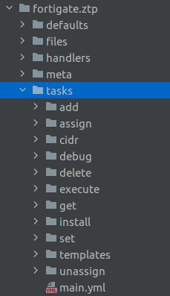
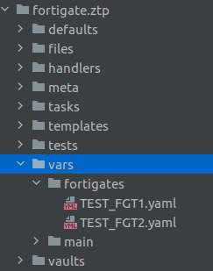
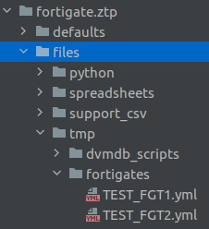
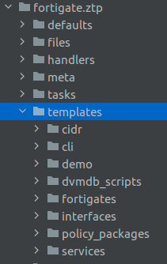
Ansible ZTP Role Folder Structure
/defaults allow for “filling in the gaps” with configuration input.
/vars/fortigates is where active configuration parameters live and is where imported data is sent.
/templates contains Jinja2 code for the Ansible ZTP data layer.
/tasks contains pre-configured API calls for creating ZTP objects.
/files/ contains python scripts, tmp files, spreadsheet inputs, and more.

Slide 17
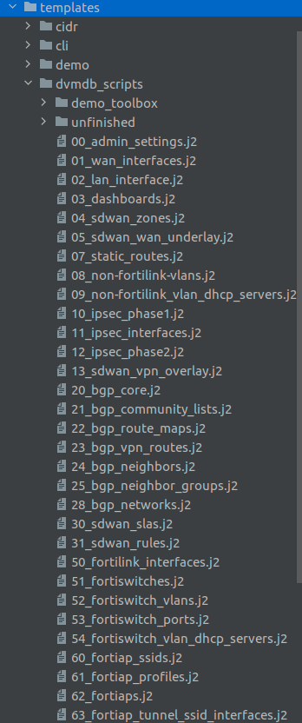
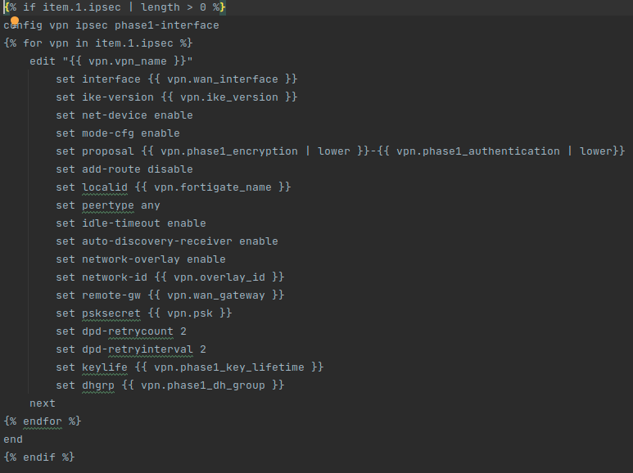
FortiGate Config Script Jinja2 Templates
Scripts have an intrinsic sort-order with naming schema.
Each templates/dvmdb_scripts/*.j2 script is run for every FortiGate YAML file under files/tmp/fortigate/
Allows for full customization for FortiGate configurations.
Can ”debug” script creation and simply copy the rendered scripts to another file location.
The README.md documentation covers this topic in more detail.

Slide 18
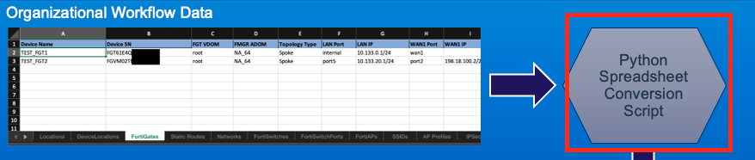
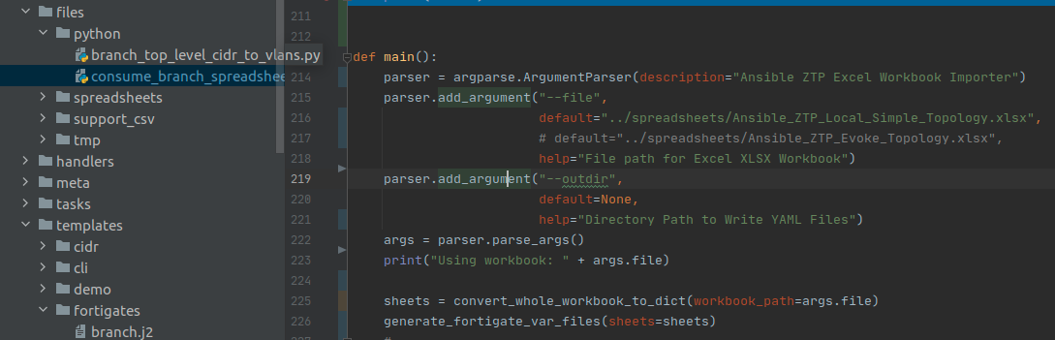
Spreadsheet to Ansible ZTP Data Conversion
openpyxl Python library provides parsing.
Follows the “Ansible ZTP Role Data Model”
Ansible Role then processes imported data.
Ansible Role can then be reset to accept a new deployment spreadsheet.

Slide 19
Deployment Workflow
Technician fills out spreadsheet
Rejection
Engineer accepts and validates
Start
Engineer Imports Spreadsheet to Ansible ZTP Role
YAML Verification & Overrides
FortiGate Registration in FortiManager
Fix Minor Issues in GUI
Delete & Return to Technician with Feedback
FortiManager GUI Inspection of FortiGate Config
End
Install FortiGate Devices in FortiManager
Reset Ansible Role Temp Data
Archive as Git Branch
Push FortiGate Config

